Slide 2
YOUR NAME
Please specify your name below
Arevik Arakelyan

Slide 3
TOOLS

Slide 4
#1
CHARLES

Slide 5
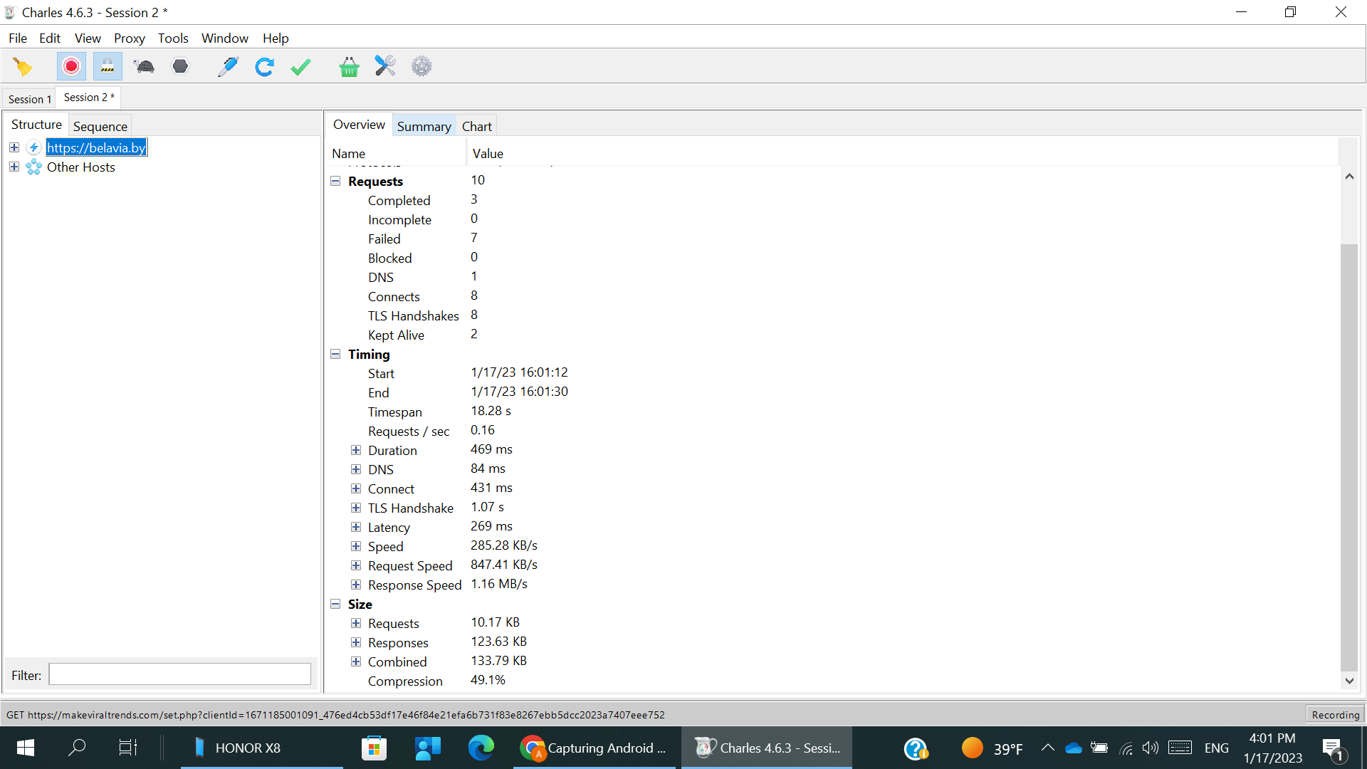
TOOLS #1.1
Open any browser on mobile phone.
Open Belavia.by web-site. Provide screenshot from Charles (Structure view)

Slide 6
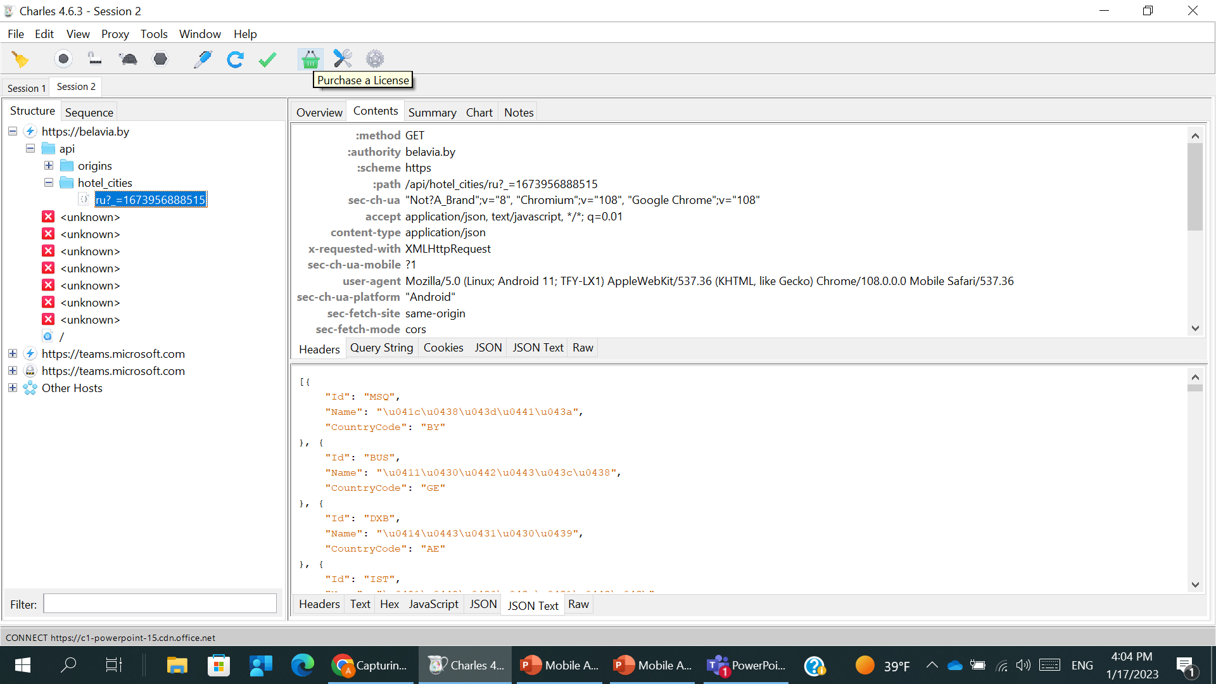
TOOLS #1.2
Provide screenshot with Request Headers

Slide 7
TOOLS #1.3
Provide screenshot with Response Headers

Slide 8
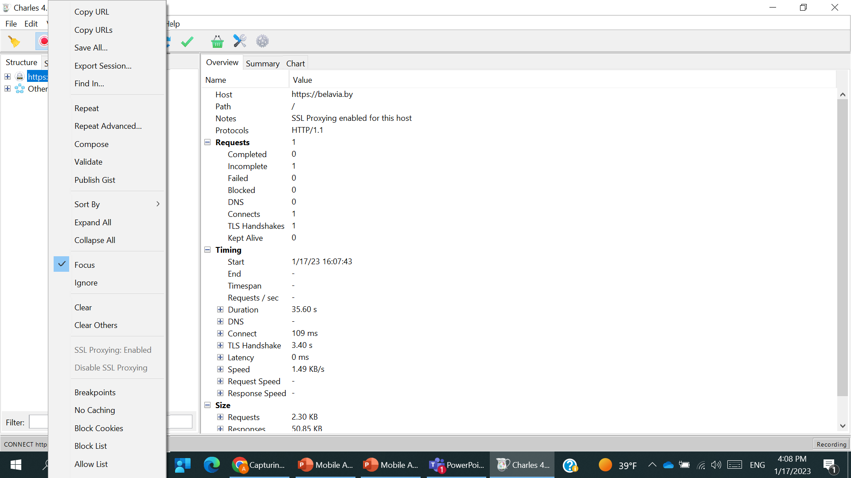
TOOLS #1.4
Focus the site in Charles

Slide 9
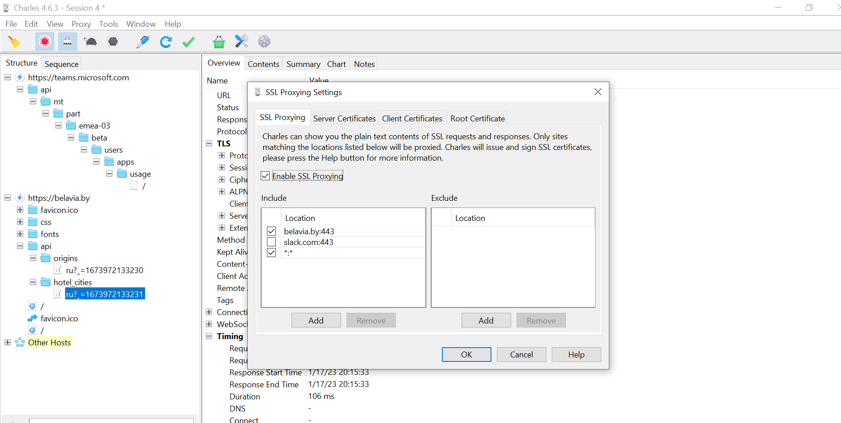
TOOLS #1.5
Enable SSL Proxying for the site

Slide 10
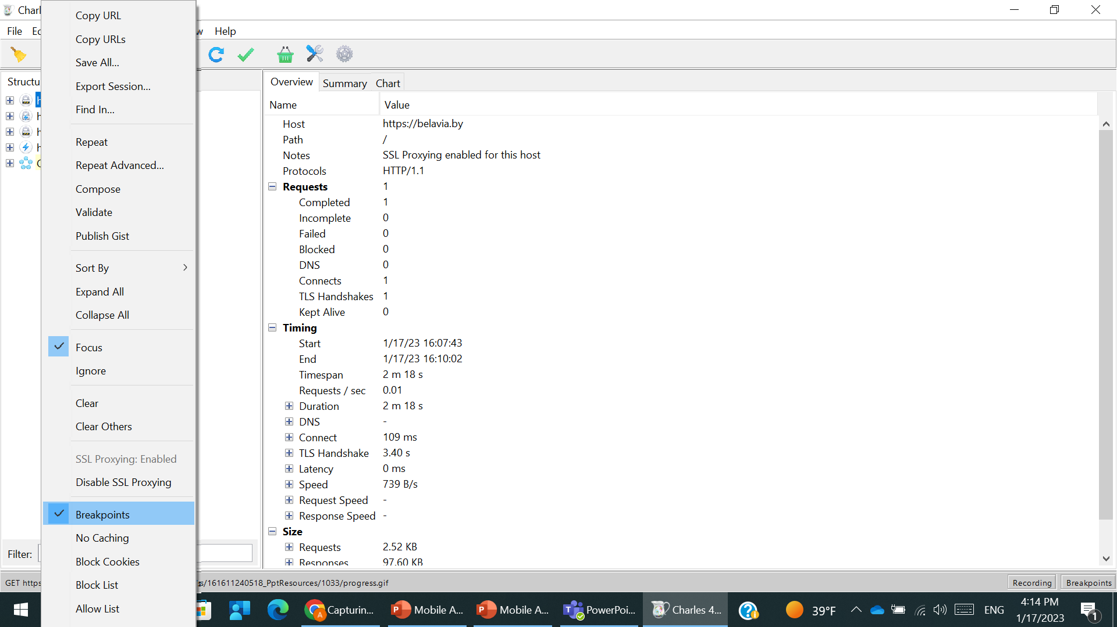
TOOLS #1.6a
Make breakpoints for the part that in charge of searching flights (поле “Откуда”)
Take screenshot with breakpoint details

Slide 11
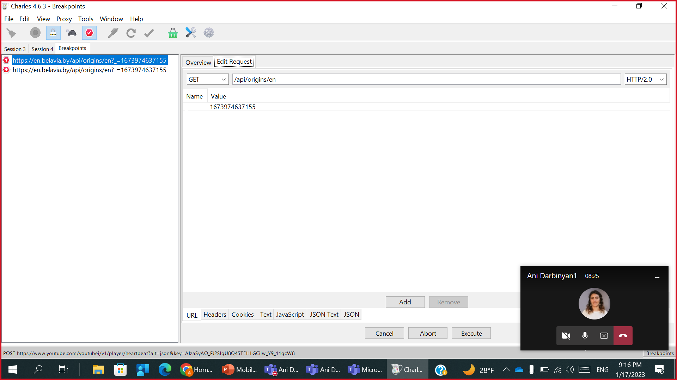
TOOLS #1.6b
Show the Request that was breakpointed

Slide 12
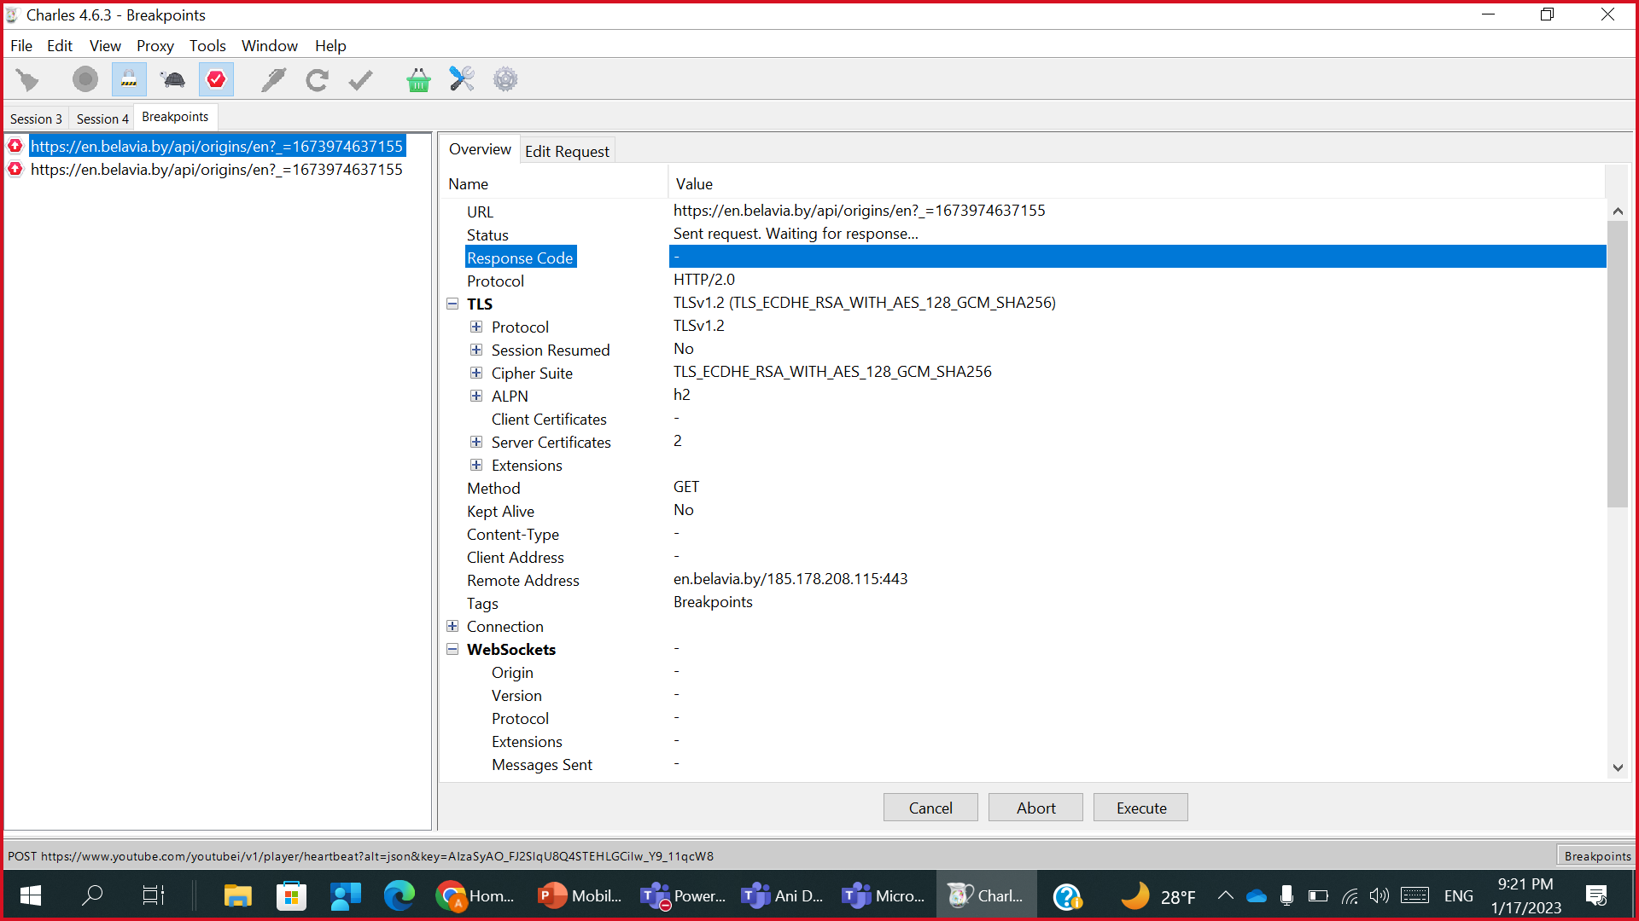

TOOLS #1.6c
Show the Response that was breakpointed

Slide 13
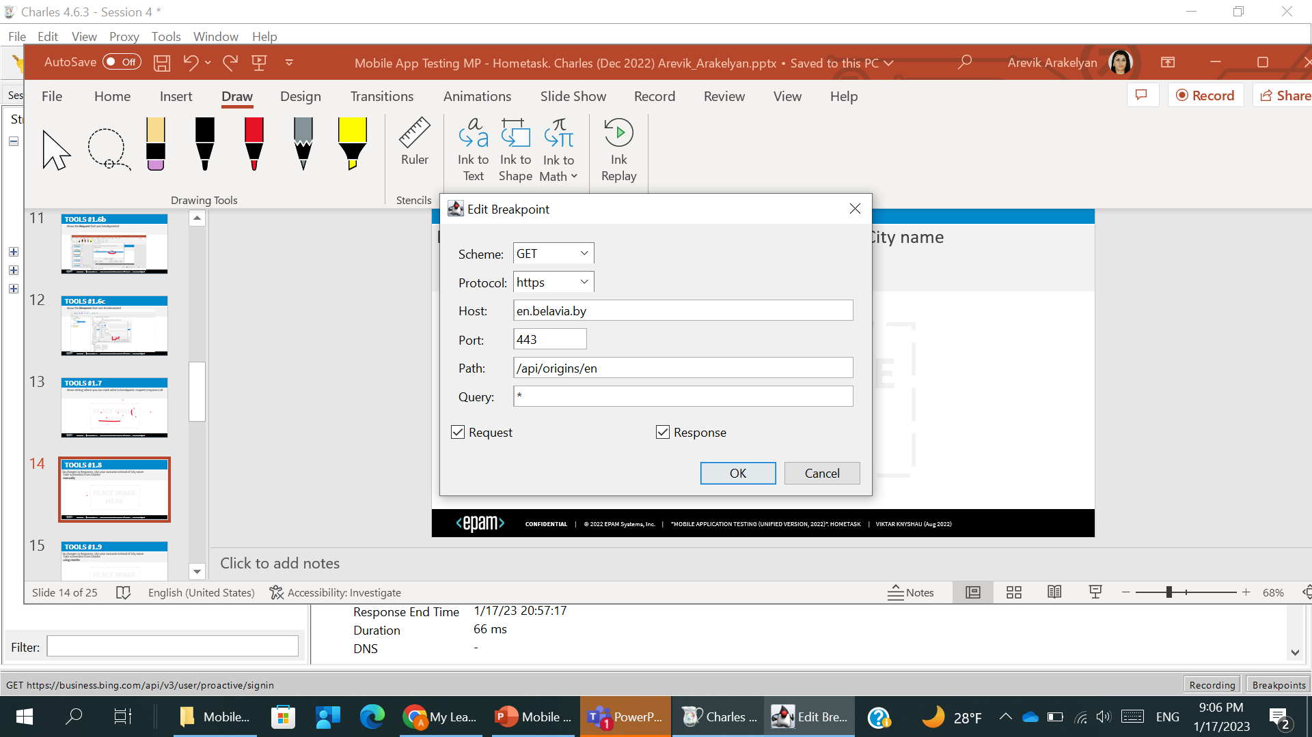
TOOLS #1.7
Show setting where you can mark what to breakpoint: request|response|all

Slide 14
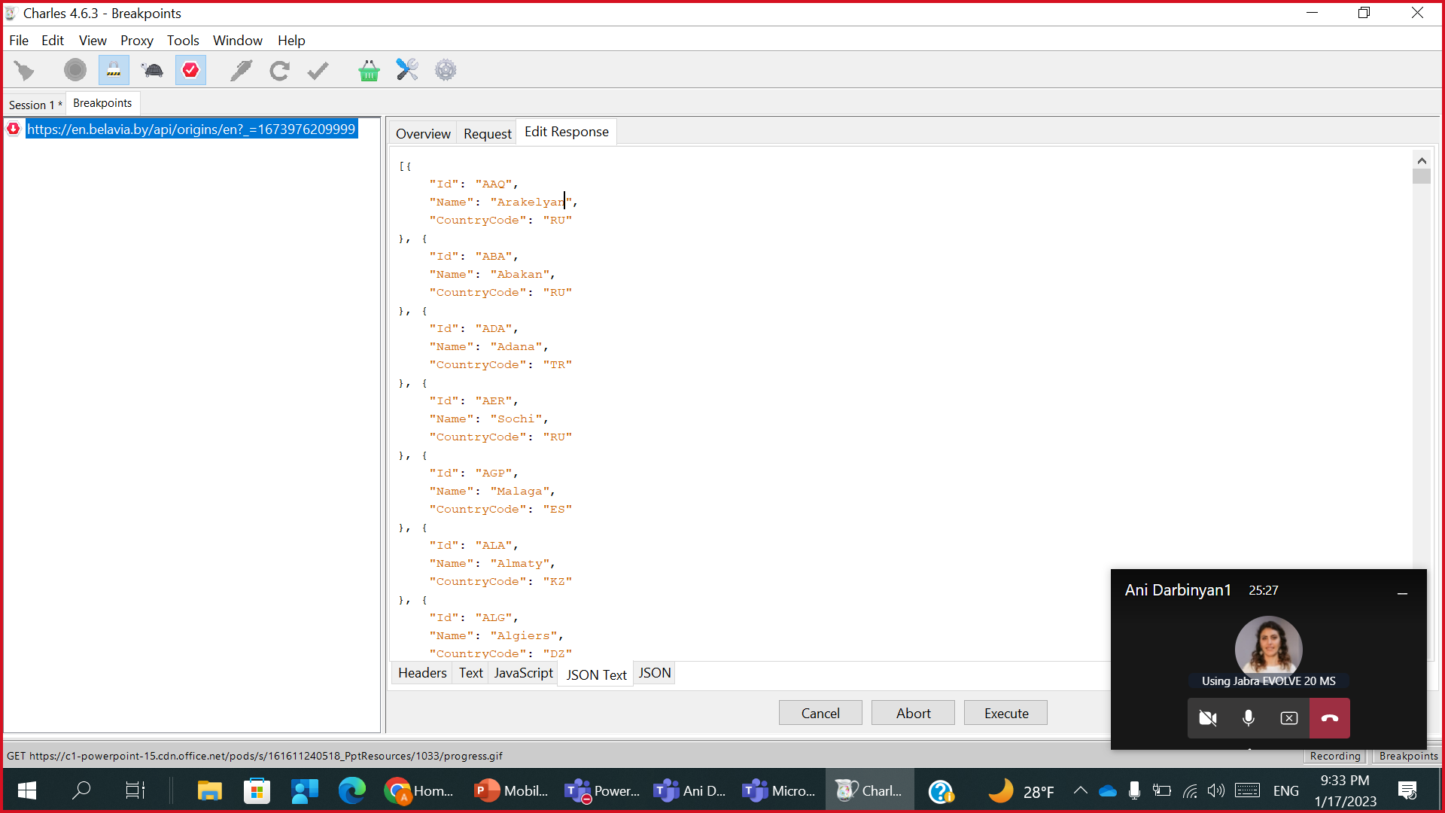
TOOLS #1.8
Do changes in Response: Use your surname instead of City name
Take screenshot from Charles
manually

Slide 15
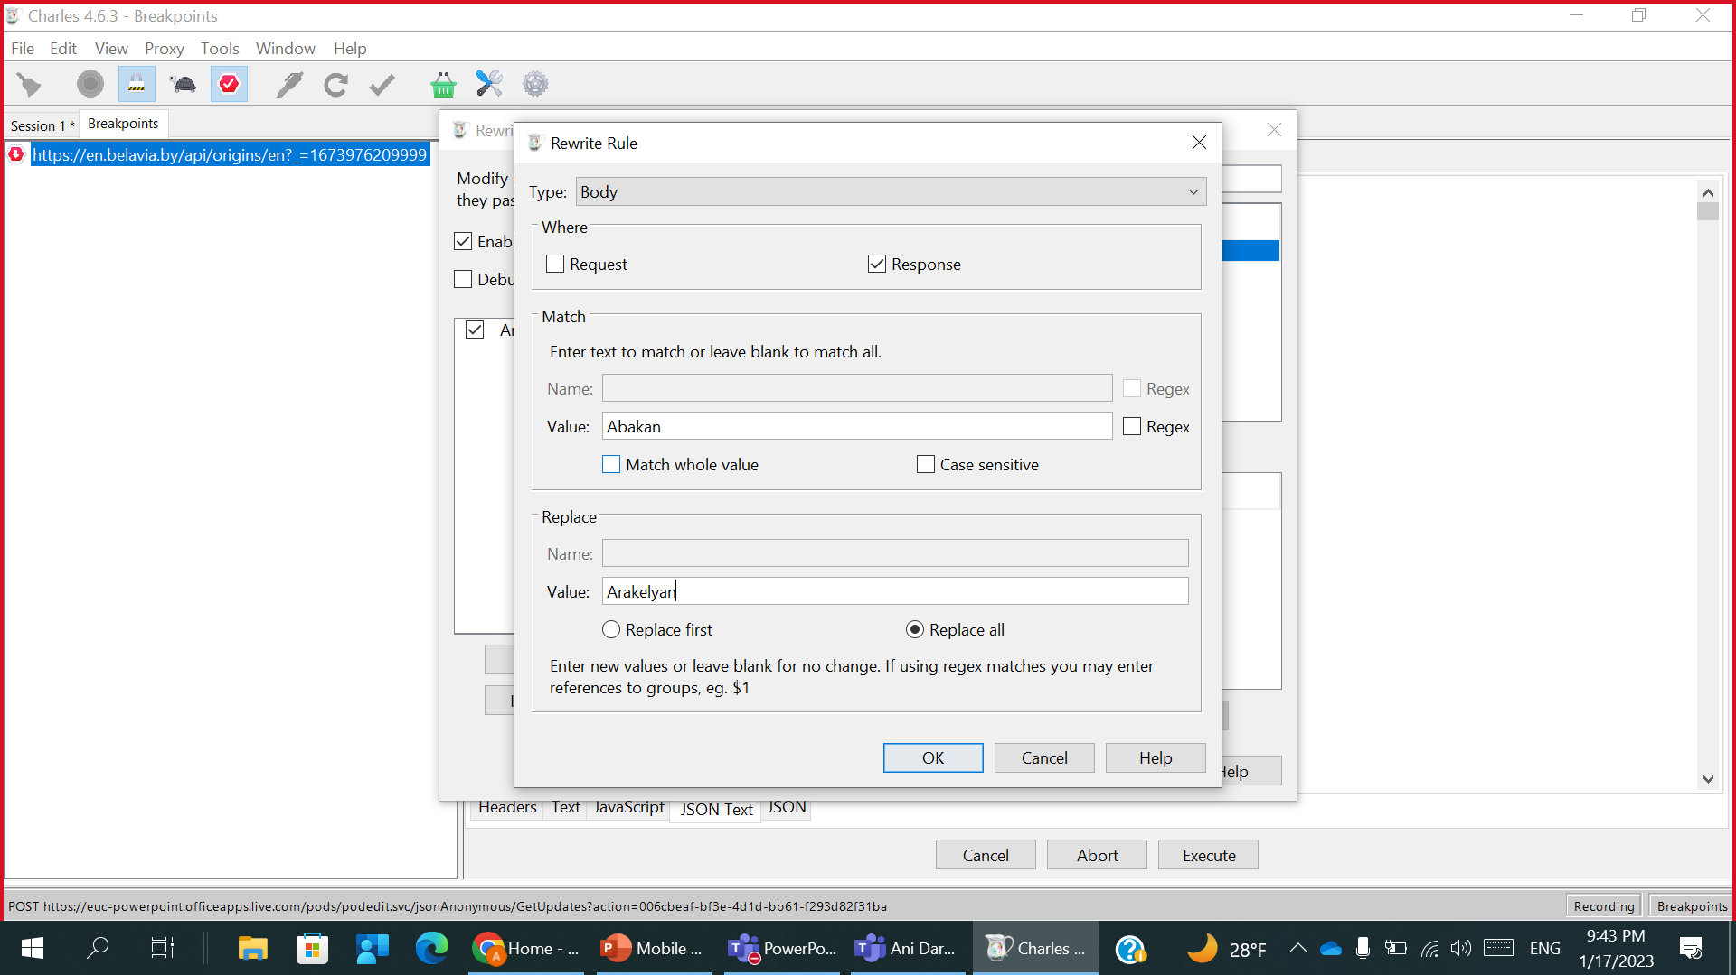
TOOLS #1.9
Do changes in Response: Use your surname instead of City name
Take screenshot from Charles
using rewrite

Slide 16
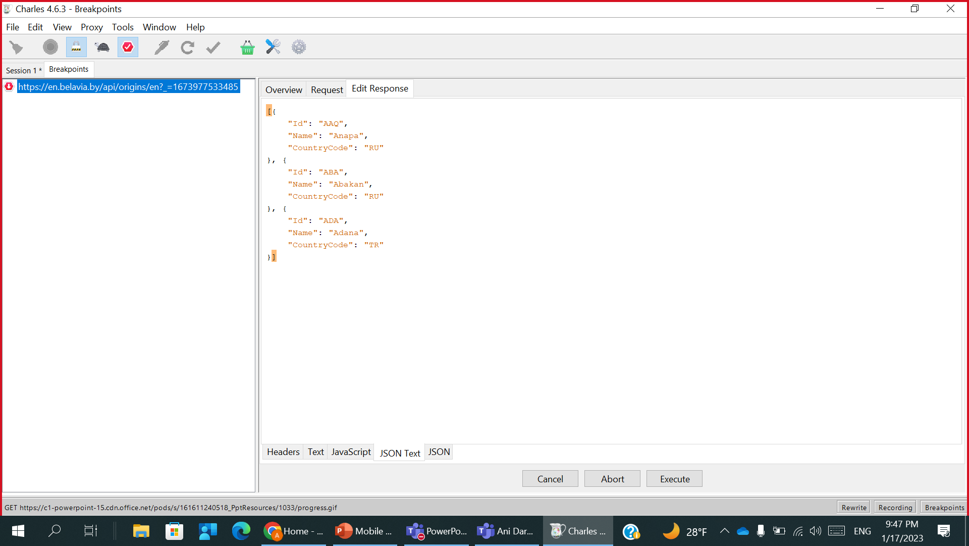
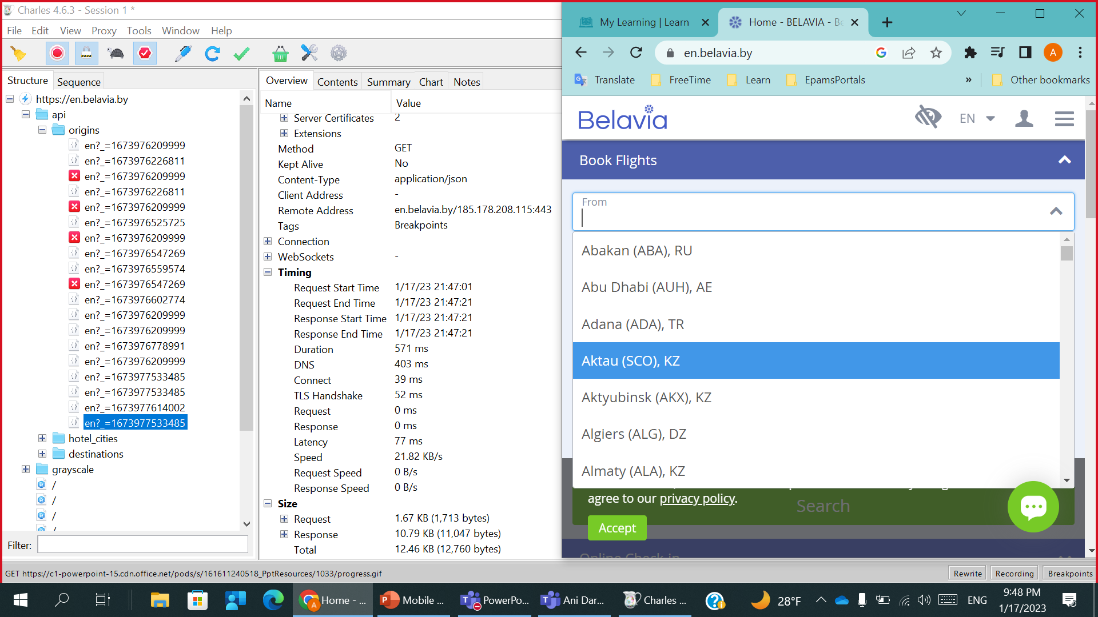
TOOLS #1.10a
Replace response. New response should have 3 cities only
Place response (text or screenshot) here
2 screenshots to be provided: from browser & charles

Slide 17
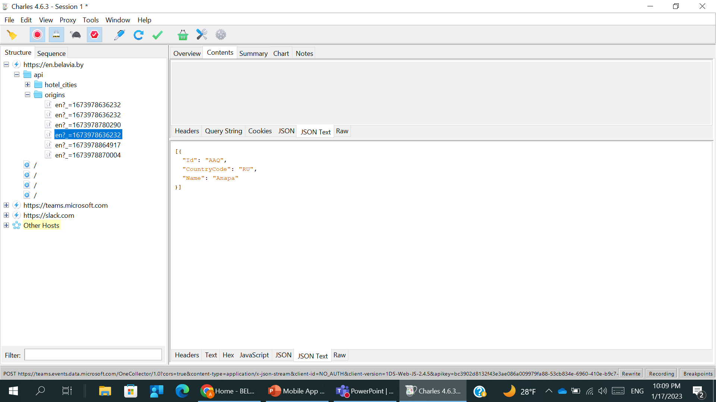
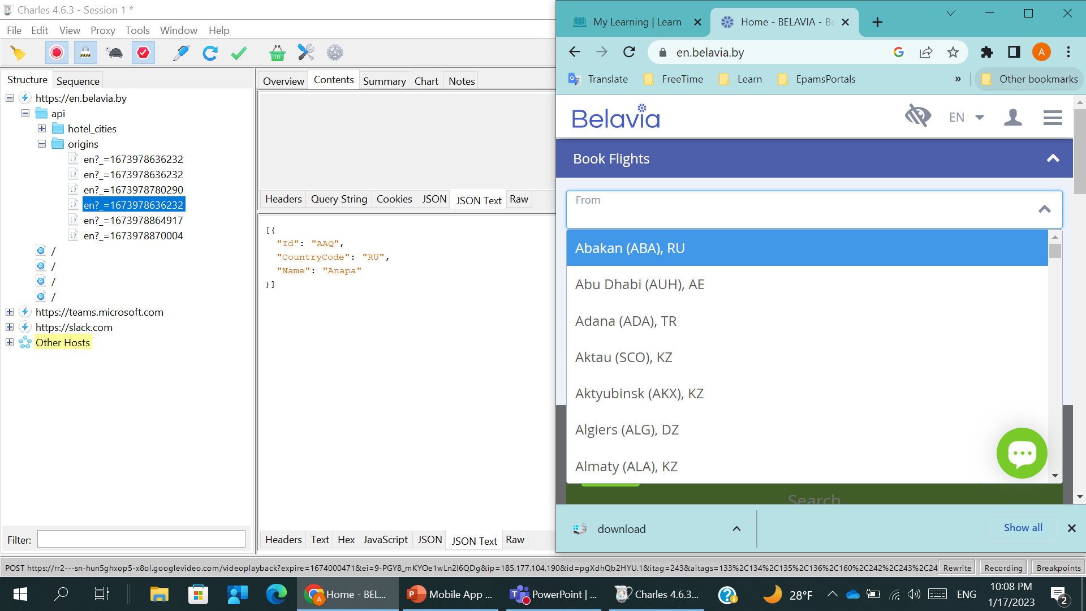

TOOLS #1.10b
Replace response. New response should have 1 city only
2 screenshots to be provided: response from charles & from browser

Slide 18
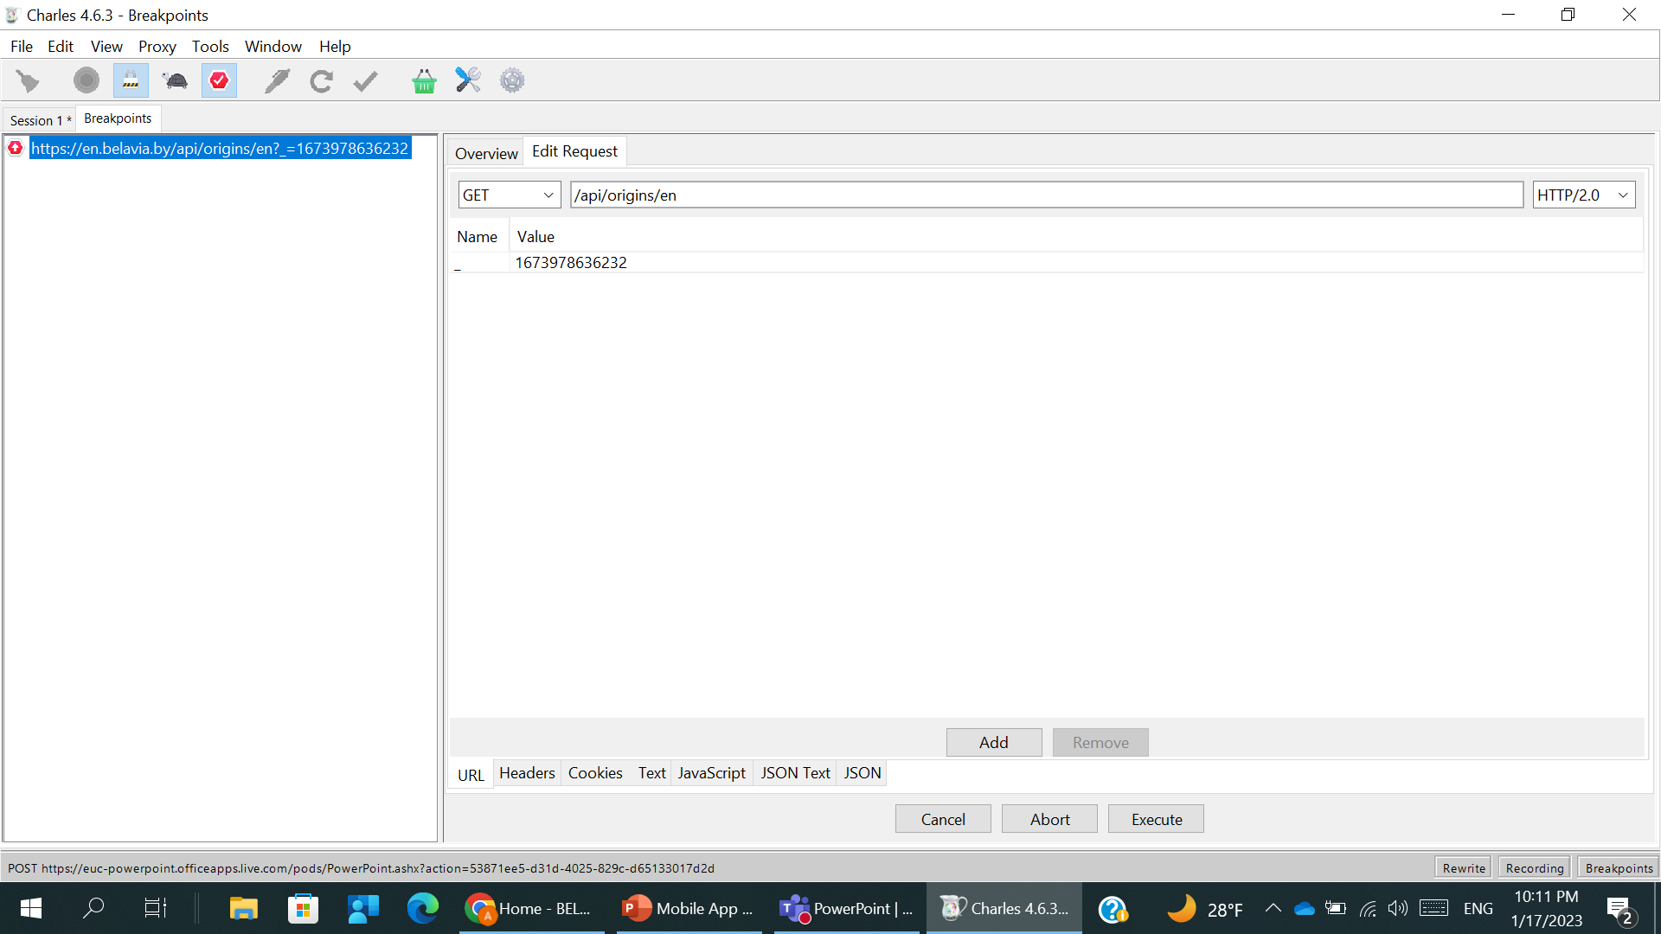

TOOLS #1.11
Find the way to abort Response.
Take screenshot

Slide 19
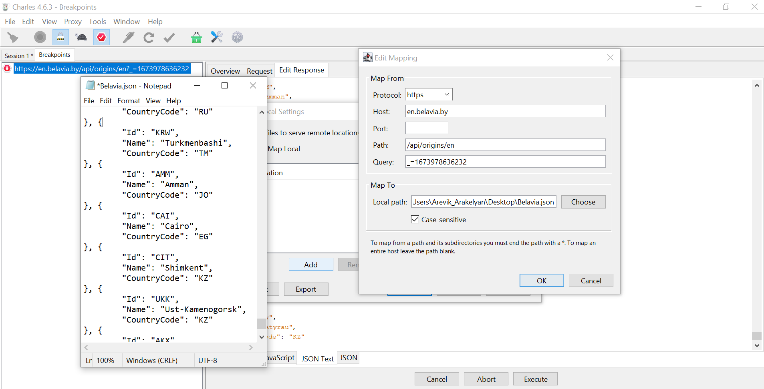
TOOLS #1.12
Change response using map local.
Provide set of screenshots to prove that you did it.

Slide 20
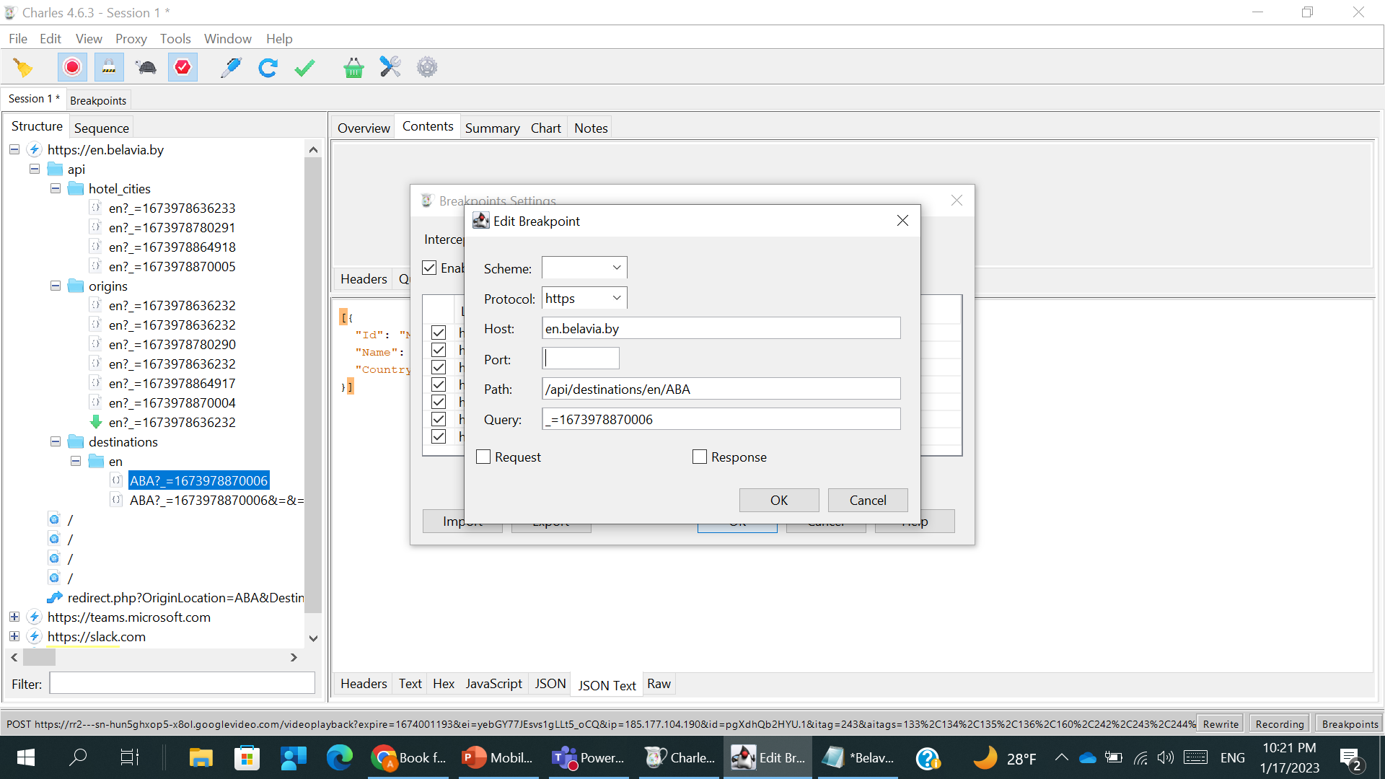
TOOLS #1.13 (optional)
Do breakpoint for the Response only that is in charge for Destination cities
Show Breakpoint settings (for this one)

Slide 21
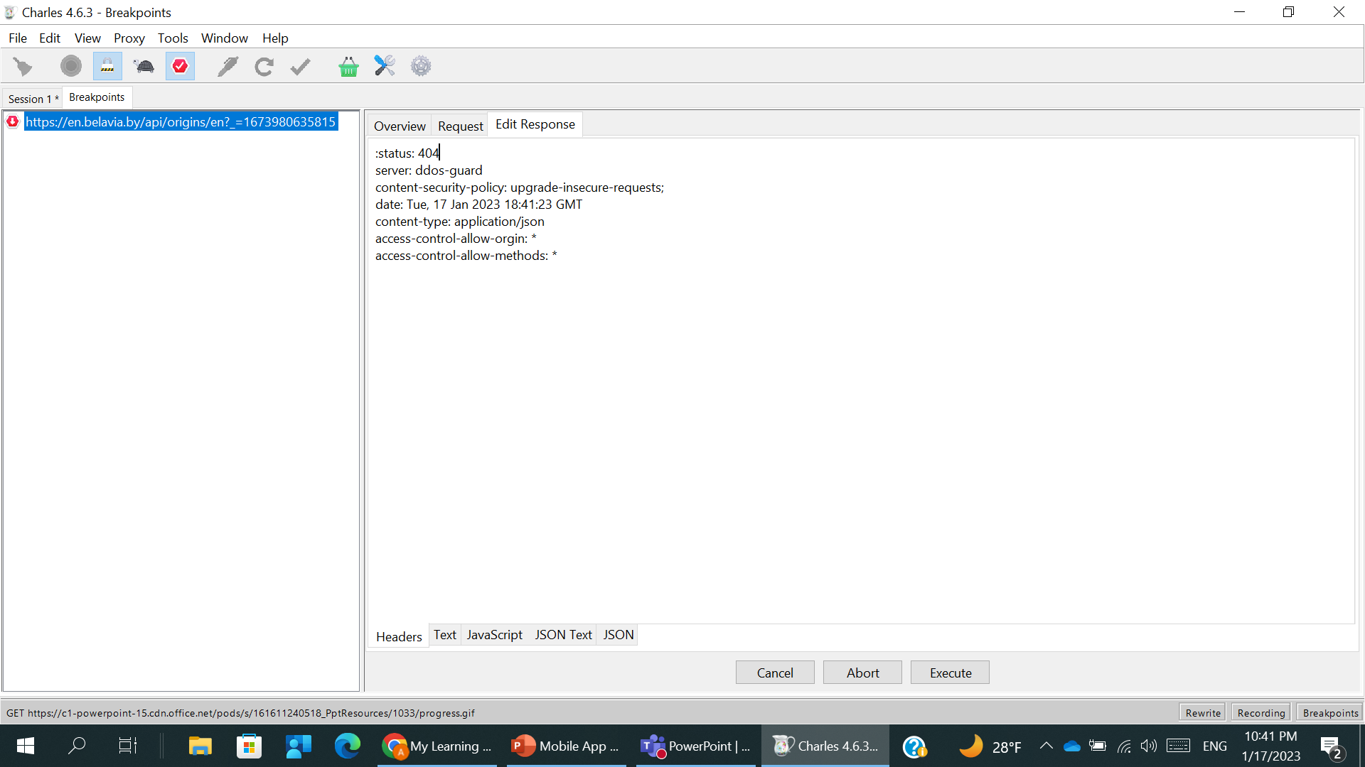
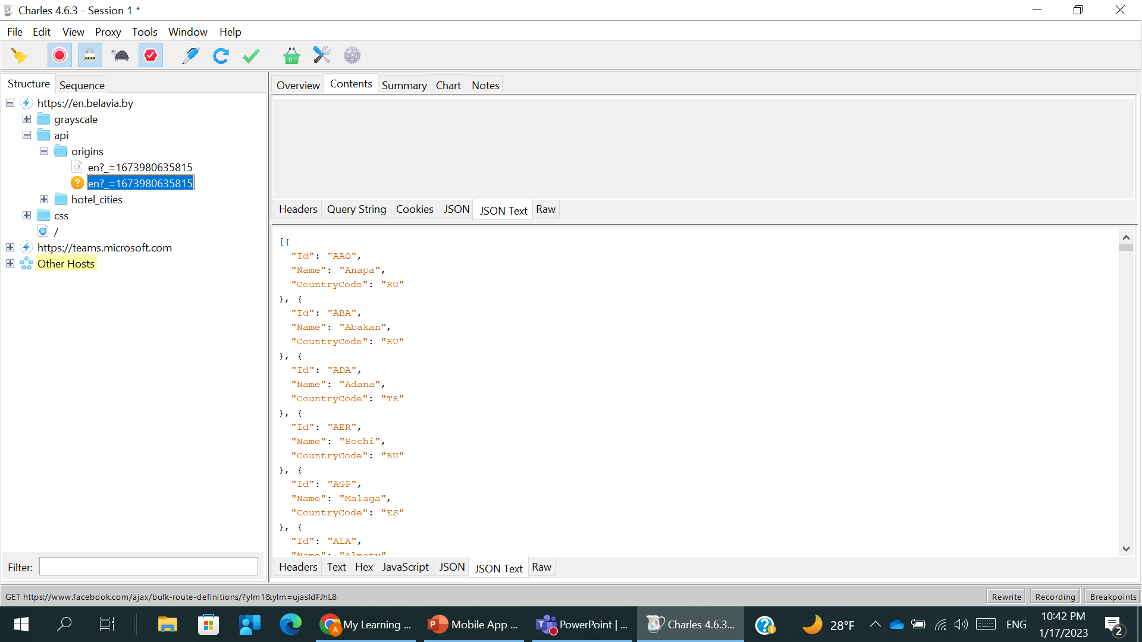

TOOLS #1.14 (optional)
Change response status for 404 using rewrite.
Show changes on web-site (show cities list)

Slide 22
TOOLS #1.15-16 (optional)
Generate following Use case. Make Response(s) screenshot from Charles
From: London (IS), The To: Capital (OF), Great Britain.
Screenshots to be provided from Charles

Slide 23
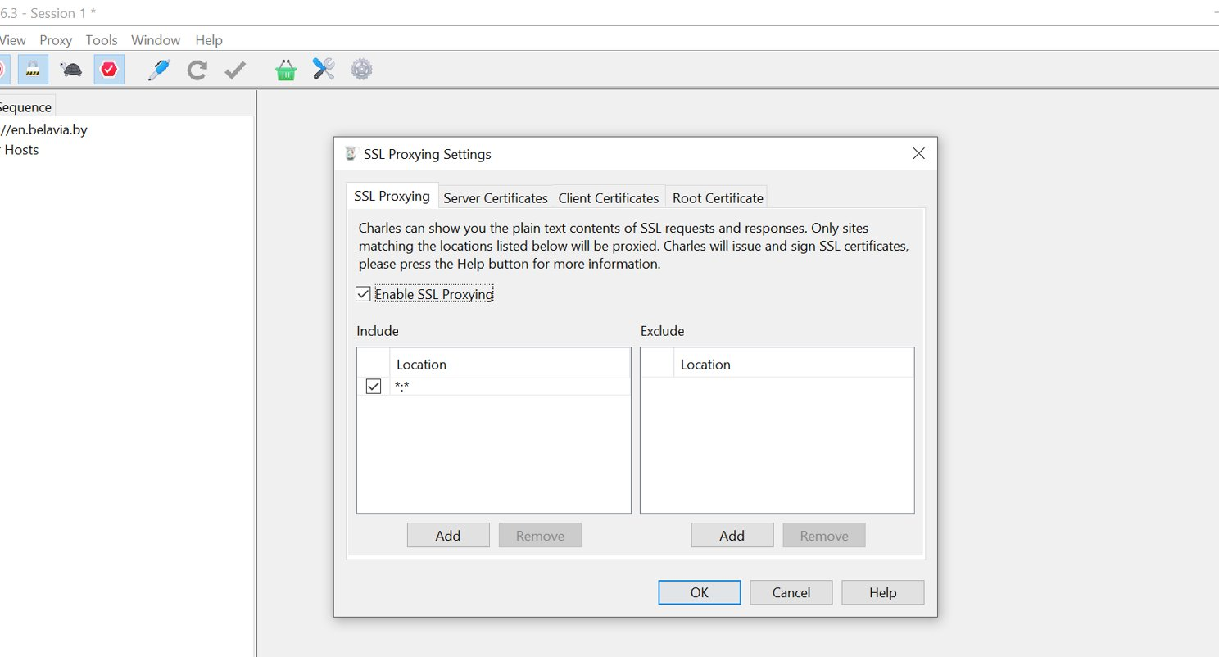
TOOLS #1.17 (optional)
Enable SSL Proxying for every site that will appear in Charles

Slide 24
ANY COMMENTS?

Slide 25
FEEDBACK FORM
Feel free to share any notes for me in case of any ☺. Some ideas:
What was the most difficult?
How much time did you spend for tasks? …
Thank you!

